Slide 1

CS 105
AVOCADO &
Demand Curve
Presenters: Tiffany Li, Sheila Shen, Alissa Wang, Shirley Wong, Yixuan Zhu
Dr. Wood April 27th, 2023

Slide 2

OUR TASK
Our objective is to create a predictive model for the total volumes of avocados sold affected by their price.
To test if the model fits the demand curve (as price increases, demand/ volume decreases).

Slide 3

OUR DATA
It is a CSV file downloaded from Kaggle.com containing the avocado price and total volume sorted by region alphabetically and year (from 2015 to 2018).
Our data includes several attributes (columns), such as "Average Price", "Total Volume", size of bags used, year, and region, as well as some invaluable ones like "4046" which makes no sense.
In total, we have 18250 data points.

Slide 4

REPRESENTATION AND PREPROCESSING
In order to represent the most valuable data, we used Pandas to do the data cleaning and solved the problems like disordered timelines. Therefore, we are easier to find the pattern in our data.
The reason for using Pandas is that it can help us sort a mixed, random dataset into a reasonable data frame.

Slide 5

REPRESENTATION AND PREPROCESSING CONT.
In summary, we dropped 4 columns (which have random column names ie. numbers)
Only kept the "organic" type because organic avocados are generally more expensive than normal ones. Otherwise, the data will affect our analysis.
Reordered the data from sorting by regions to sorting by date in ascending order.
Changed the type data of values in "Date" column from strings to numeric, so the model can detect directly.

Slide 6
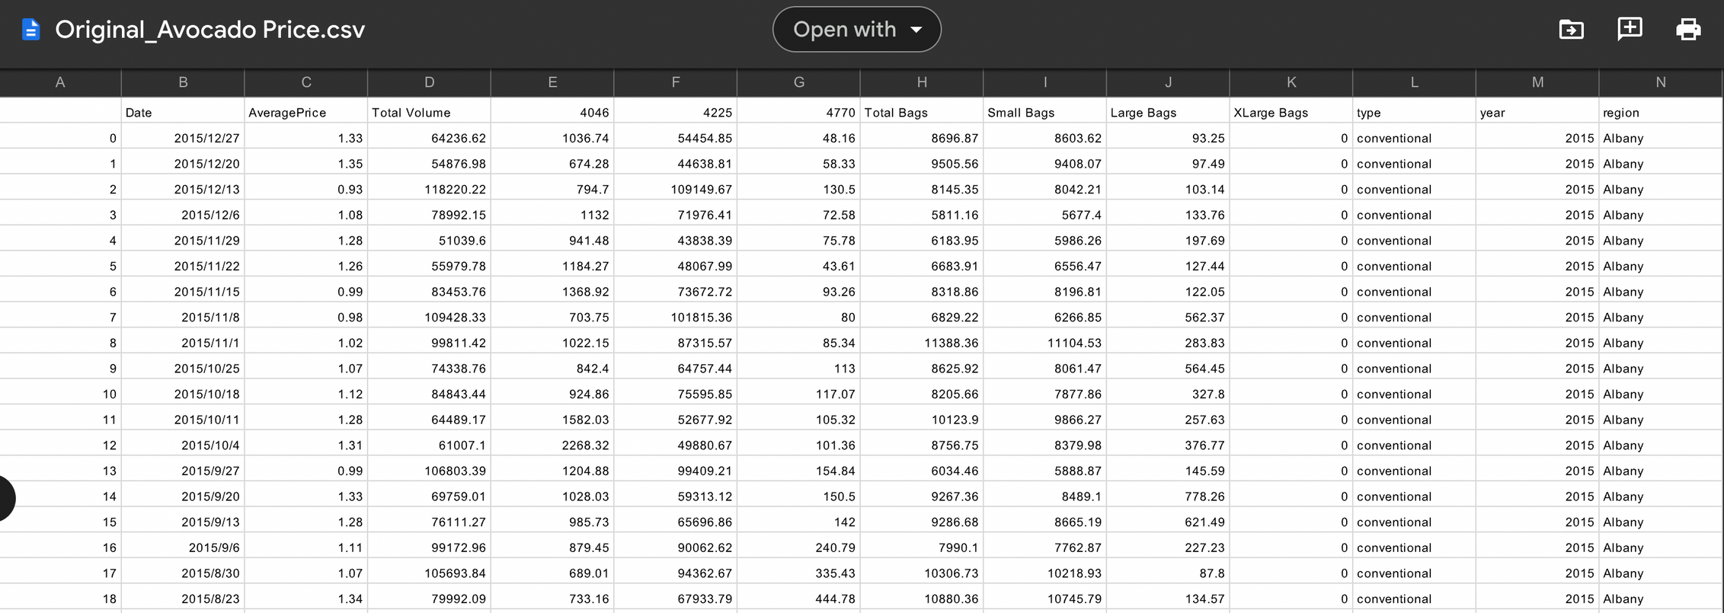
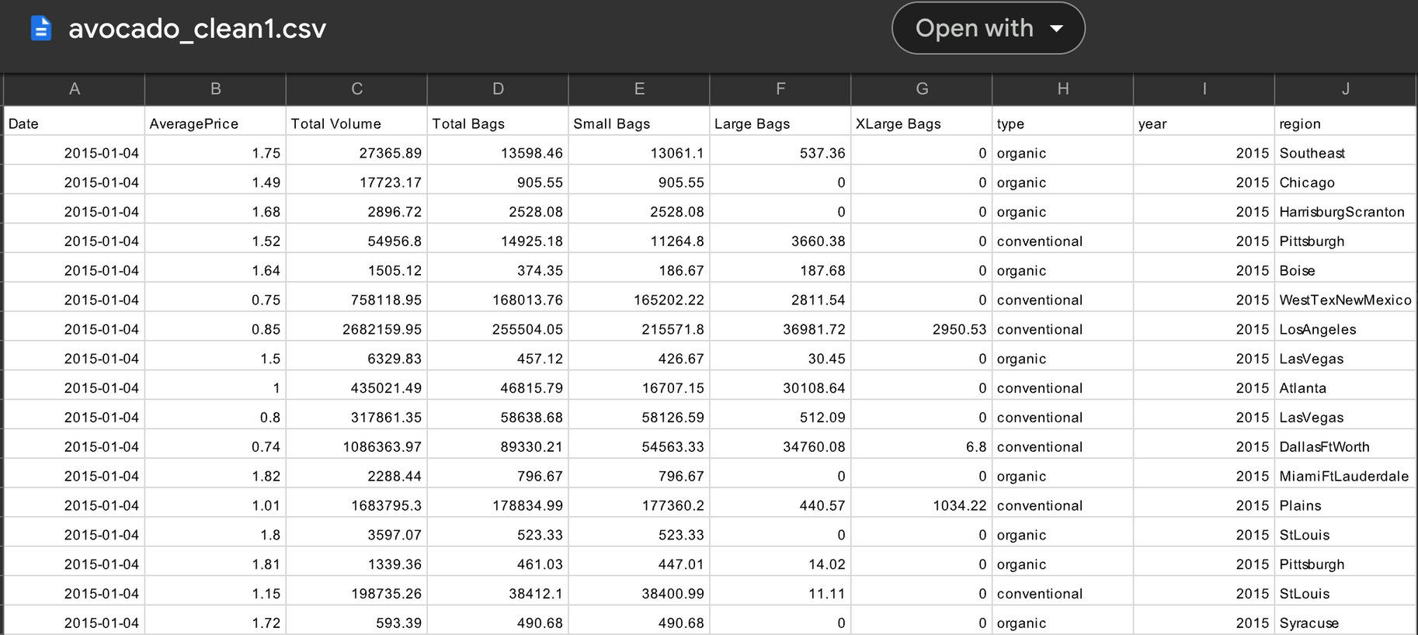
CSV BEFORE VS. AFTER

Slide 7
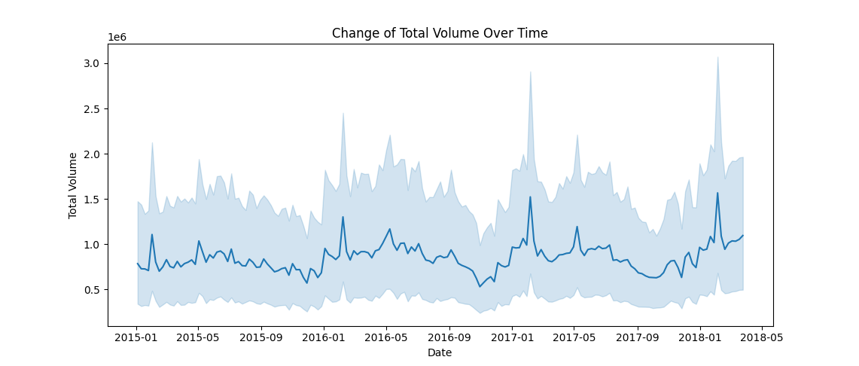
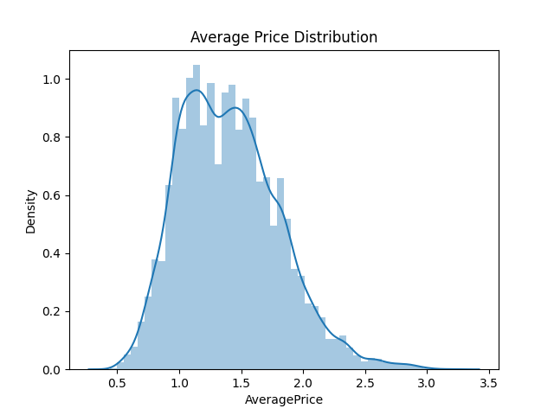
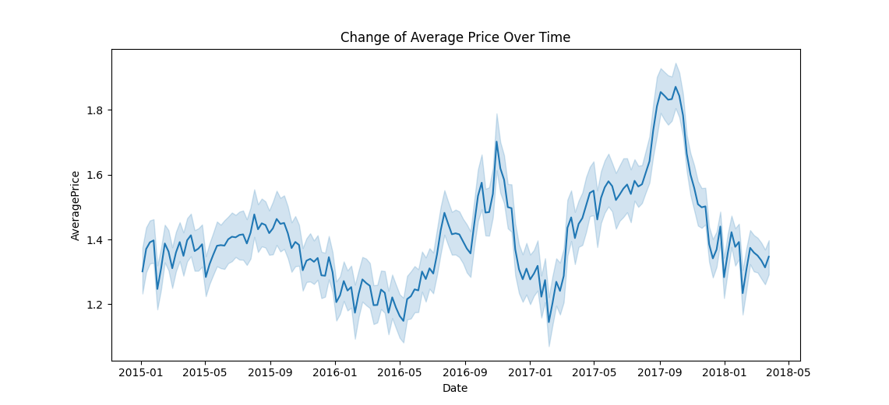
VISUALIZATION

Slide 8
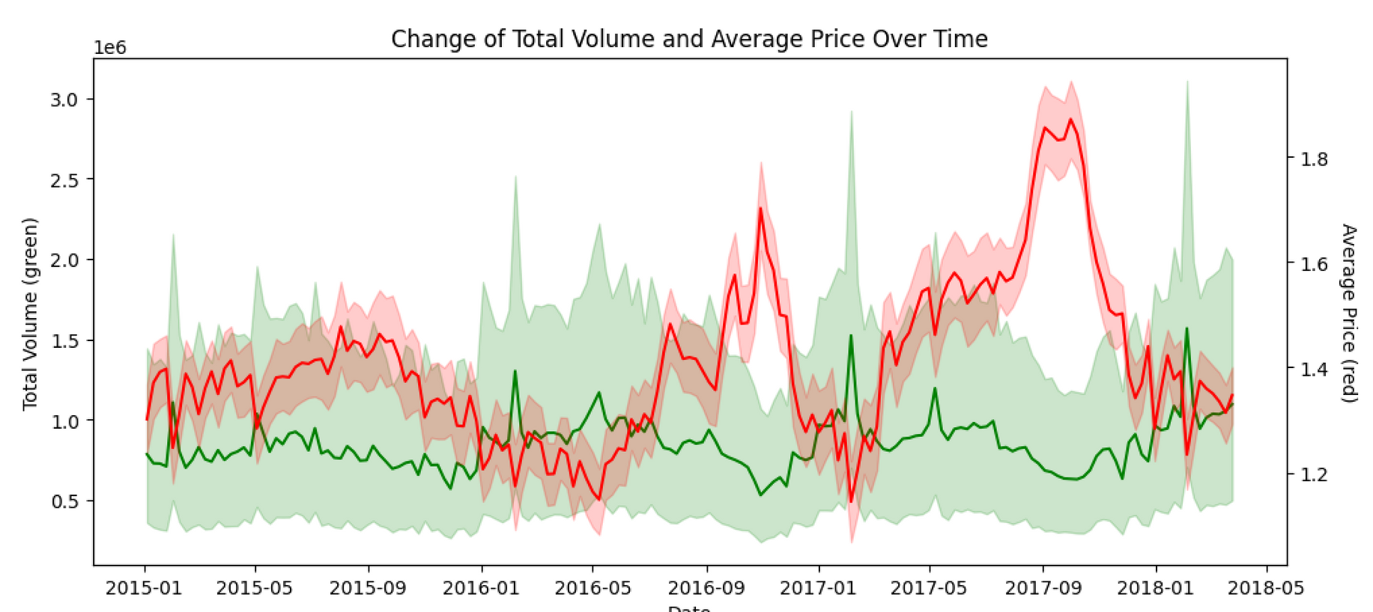
VISUALIZATION

Slide 9


MODEL SELECTION
Use price to predict total volume
OLS, Simple linear regression
Linear regression allows us to use independent variable to predict dependent variable, which in this case, we can use avePrice to predict total volume, and analyze the tendency.

Slide 10

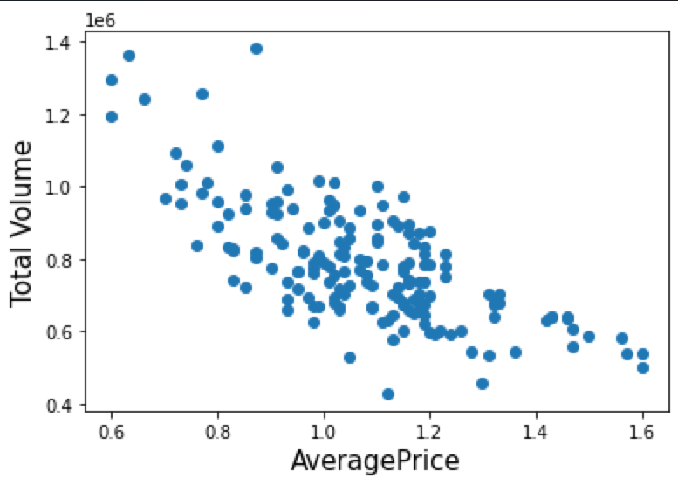
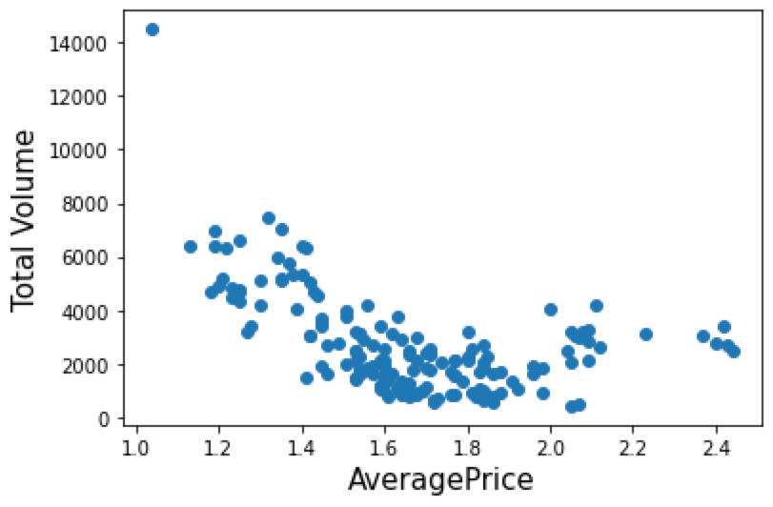
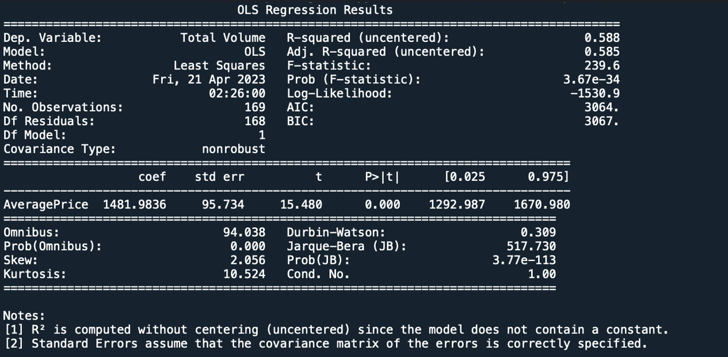
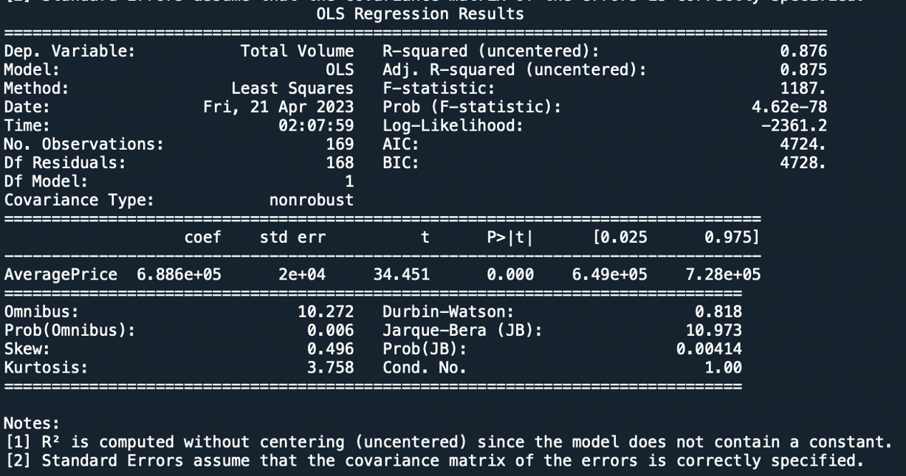
MODEL EVALUATION
Syracuse
Las Vegas

Slide 11
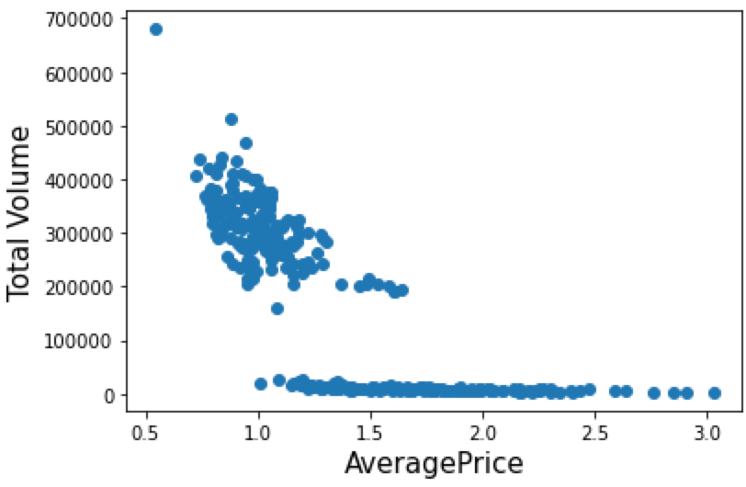
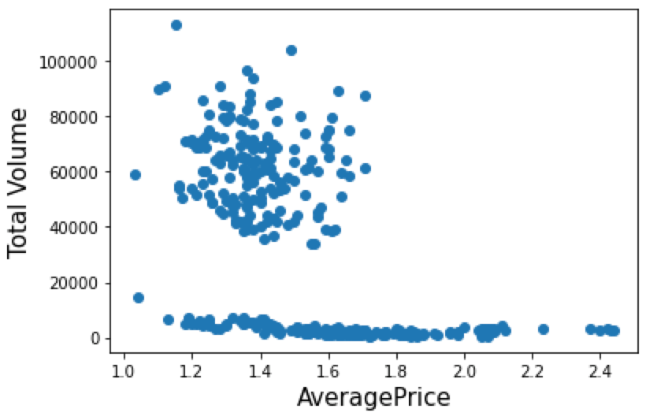

LIMITATION
Too many regions and dates are included in the file, so we decided take region as our index in the data frame.
Too much Region: Our first choice is Boston, but the tendency is NOT obvious. So we choose Las Vegas & Syracuse to represent South and North.
Different Type of Avocado with different avePrice.
Las Vegas
Syracuse
Notes:
Boston的图并没有明显的趋势，有可能是Boston范围比较大，avocado店各不相同，不同区域的情况不一样，更细节的信息没有收集在data中

Slide 12

CONCLUSION
Demand curve fits for most of the cities, but there are still minor cities like Boston doesn't fit for this model.
Next step： Improve the model by taking into consideration other elements.

Slide 13
THANK YOU

